Slide 1
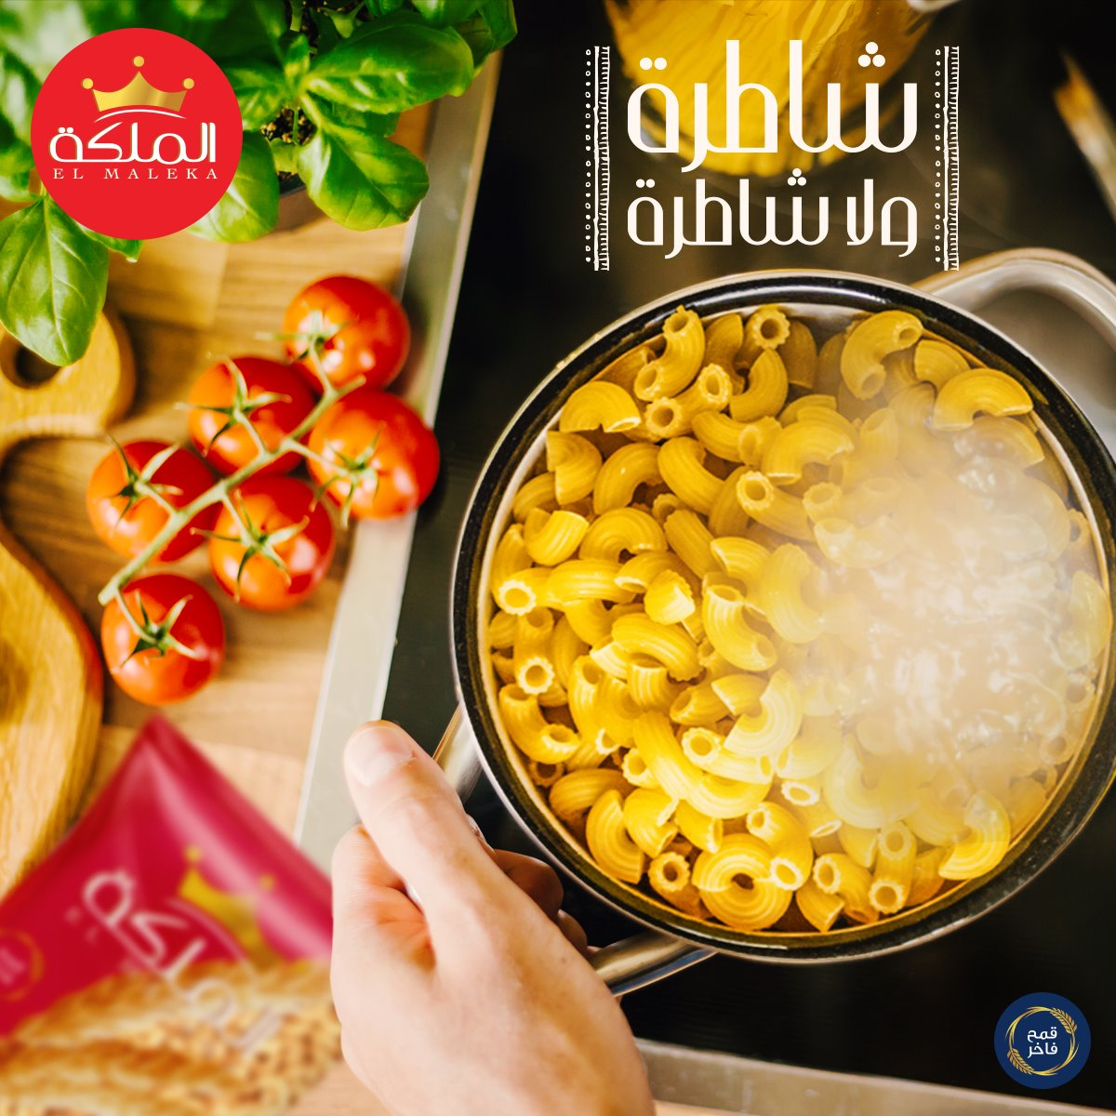
الملكة EL MALEKA
Nourhan Walid
Omar ElHusseiny
Haneen Hassan
Esraa Abdelaziz
Dina Khaled

Slide 2
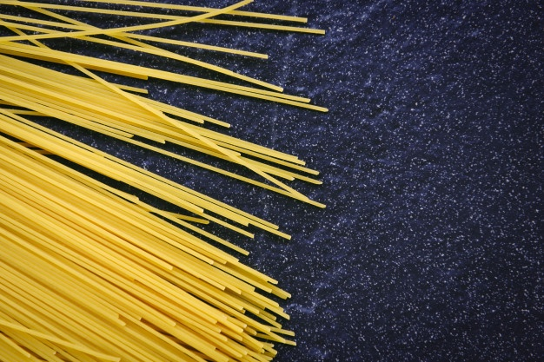
Background information
El Maleka is a leading pasta company in the Egyptian market. It was acquired by a Saudi Company (Savola Group). El Maleka offers high-quality pasta at an affordable price. It is Egypt's most popular pasta brand, as it provides various shapes of pasta

Slide 3
Problem Definition
Management Problem | Marketing Research Problem
What should be done to regain/increase El Maleka’s market share among El Maleka’s competitors | Determine the strengths and weaknesses of El Maleka verses its major competitors with respect to consumer purchase decision

Slide 4
Components/objectives
What are all pasta brands that El Maleka’s segment considers buying?
Criteria by which consumers choose pasta brands
How do consumers evaluate El Maleka and other pasta brands in terms of criteria identified?
What are psychographic and geographic profile of El Maleka consumers and other brands?

Slide 5
Findings of decision maker discussion
Market share from 2018 → 2021
El Maleka’s major Competitors according to DM
Strengths and Weaknesses of El Maleka in the DM’s point of view:
Strengths | Weaknesses
Affordable prices Available everywhere | Quality (consistency, cracking) Appearance of سوس

Slide 6

Findings of industry expert interview
Market share
Quality compared to other brands of the same segment
Personal Selling
Competitors
Prices are affordable
Best selling brands

Slide 7

Characteristics of focus group’s participants
Number of participants
6 participants
Gender
All women
Ages
Ranges from 30 to 55
Occupation
All are housewives except one
Environment of the focus group
Comfortable environment, in a sporting club

Slide 8

findings of focus group
Quality of El Maleka vs. its major competitors
Old fashioned packaging design
Convenient prices
Variety of shapes is satisfying
Sales promotions are important
El Maleka improvement

Slide 9
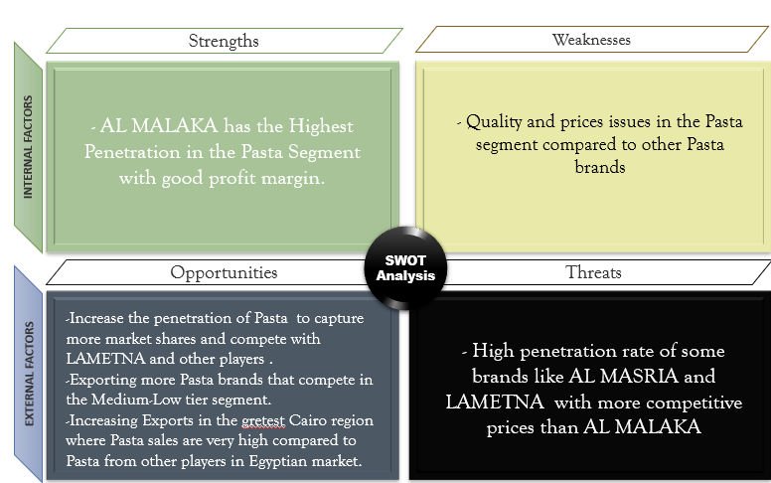
Internal secondary data ready to use

Slide 10
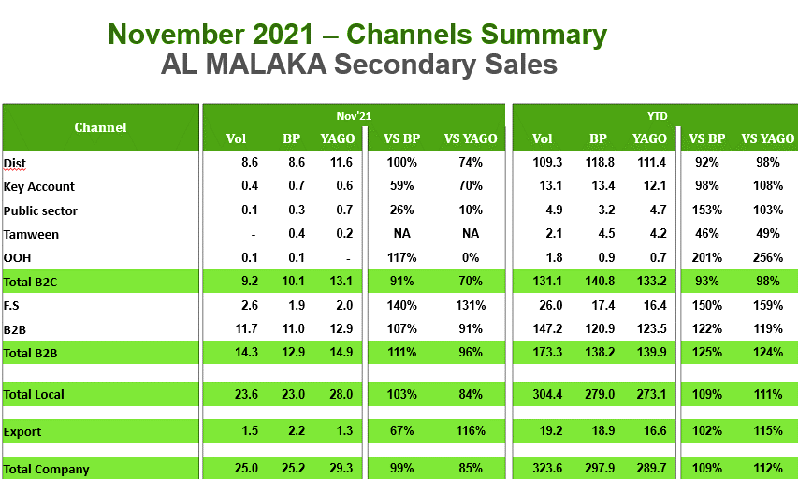
Internal secondary data ready to use

Slide 11
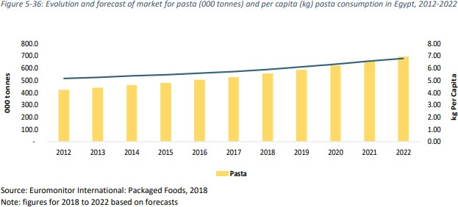
external secondary data Computerized, internet database
From 2012 to 2017, it was realized that pasta consumption in Egypt has increased at an annual rate of 4.6%.
From year 2017 to 2022 it is expected for the pasta consumption to increase from 528 000 tons to 693 000 tons
(The Food and Beverage Market Entry Handbook: Egypt, 2022)

Slide 12
external secondary data Computerized, internet database
Competition In the Pasta Industry
Two of the most important competitors of El Maleka in the pasta industry are
Star | Hawwa
Competitive advantages Affordable prices Good distribution | Competitive advantages They have their own mill. Affordable prices Experience over 55 years.

Slide 13
Graphical analytical model
Quality
Price
Sales Promotion
Customer Purchase Decision
Personal Selling
Packaging design
Dependent Variable
Product Variety
Word of Mouth
Independent Variables

Slide 14
Research questions How do consumers evaluate El Maleka and other pasta brands in terms of criteria identified?
RQ8: How do customers evaluate quality of El Maleka and other competing brands?
RQ10: What makes price convenient to consumer?
RQ11: How convenient are sales promotions made by El Maleka vs. other brands?
RQ12: How effective is personal selling of El Maleka according to customers’ purchase decision?
RQ13: How do customers evaluate El Maleka’s package design?

Slide 15
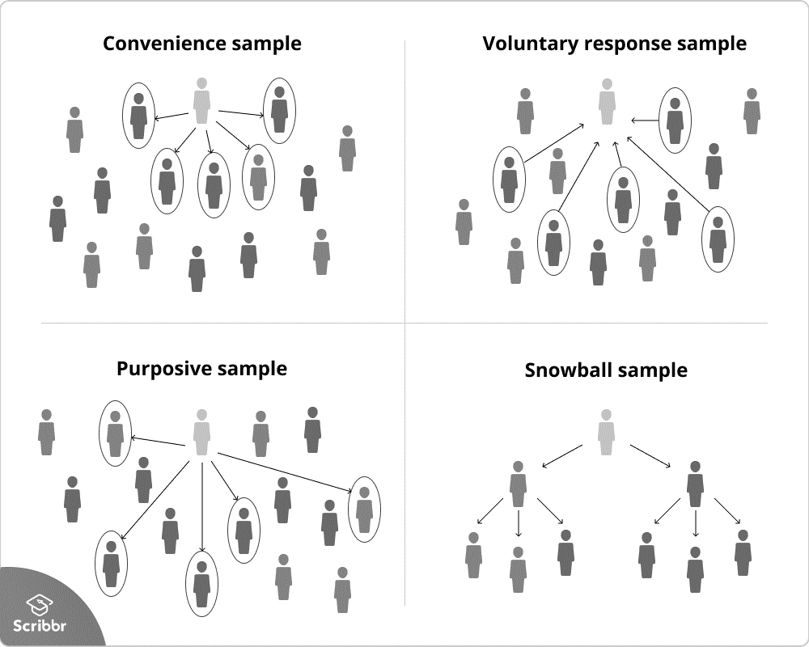
Sampling techniques
Nonprobability Sampling
Convenience Sample
Snowballing Sample

Slide 16

Pretesting
Question Number 2
Question Number 24

Slide 17
questionnaire findings and discussion
El Maleka is the most consumed product among its major competitors
Quality of El Maleka regarding consistency, cracking, amount of starch produced
Quality and portion make prices convenient
Respondents don’t know or rarely find sales promotions on El Maleka products
Respondents don’t know or never found salespersons for El Maleka
Respondents find packaging design appealing compared to major competitors

Slide 18
Thank you
Any Comments?

